Slide 1
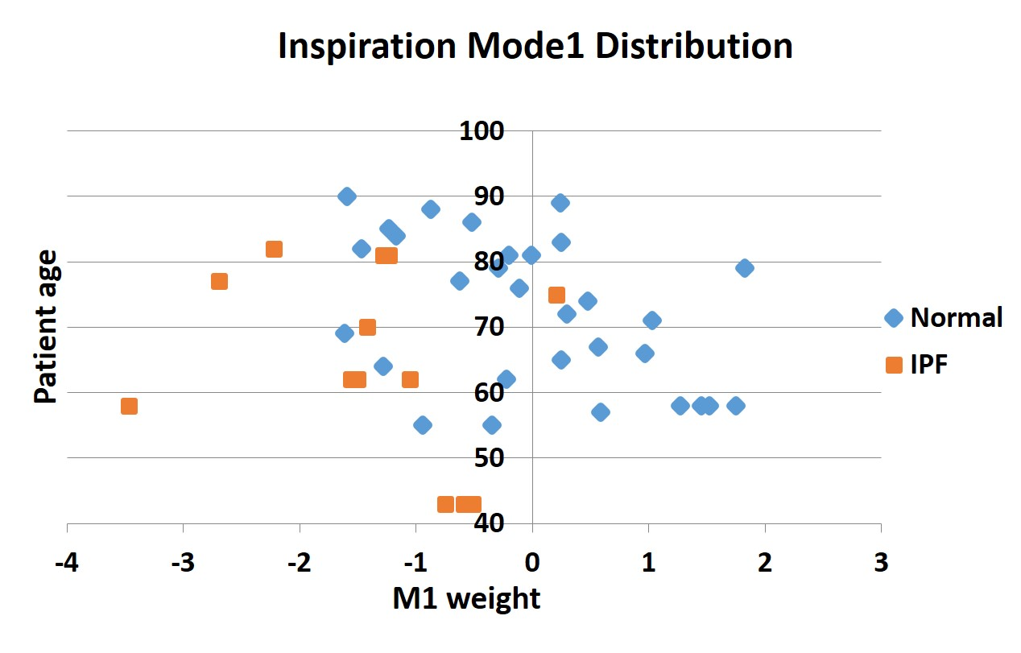
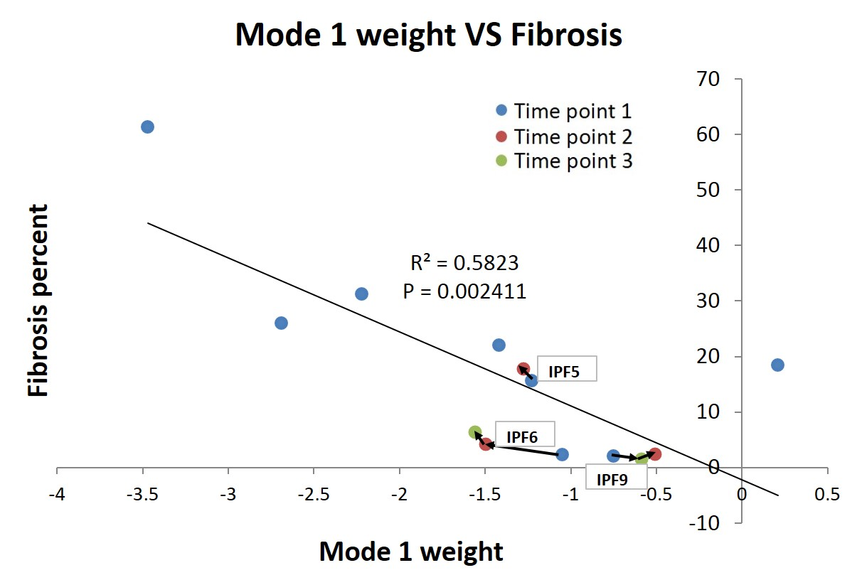
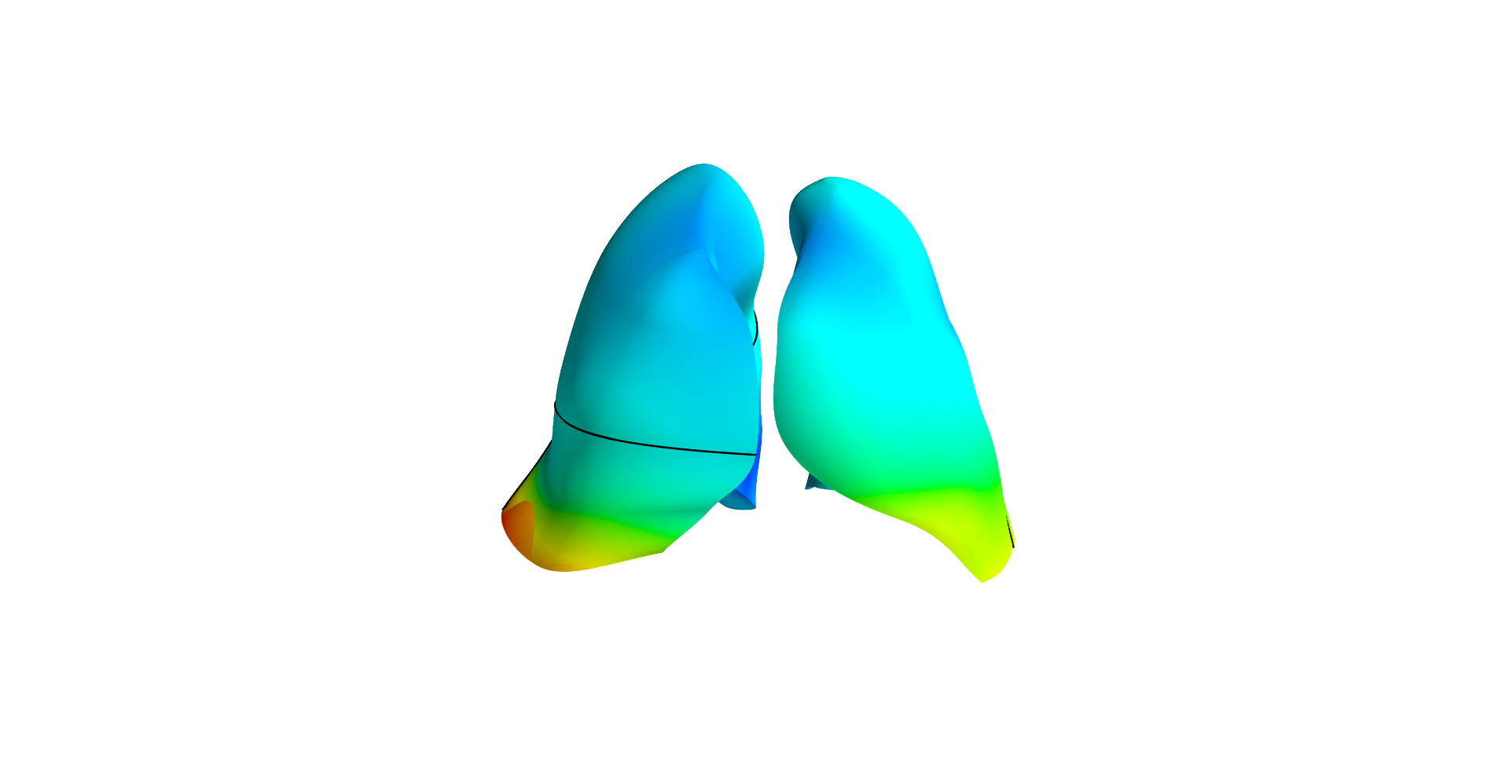
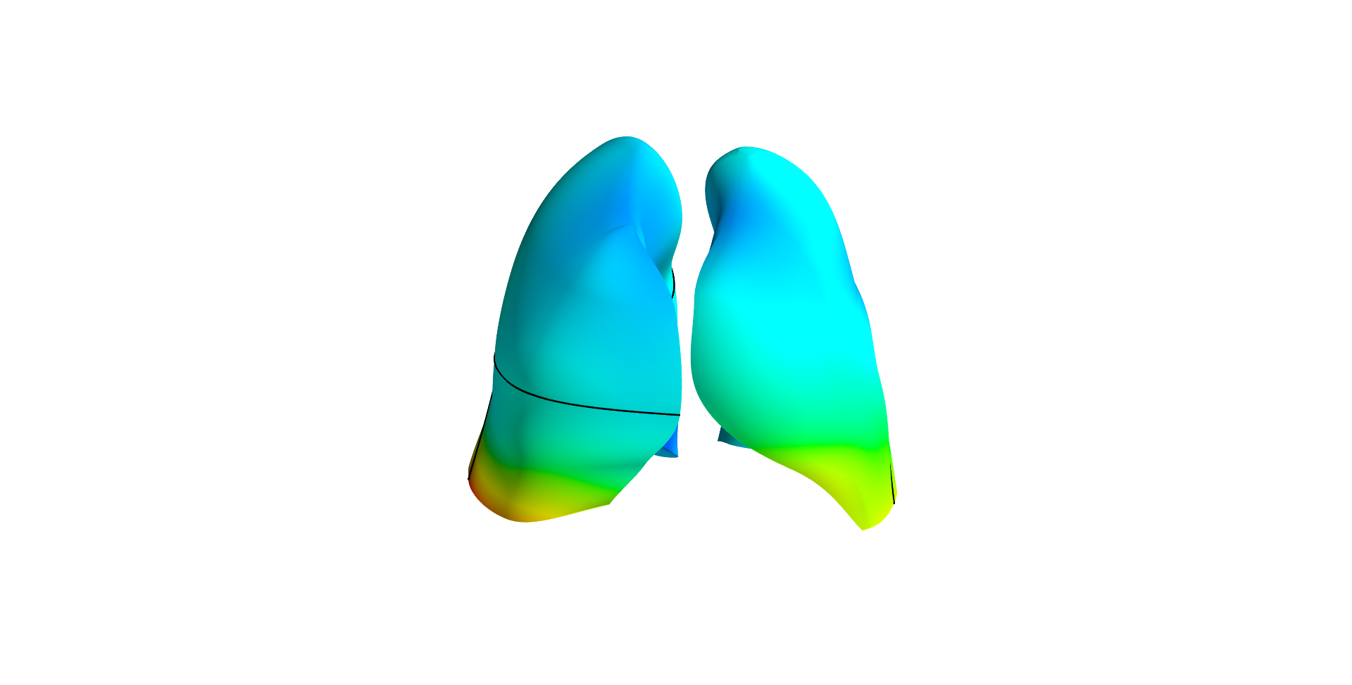
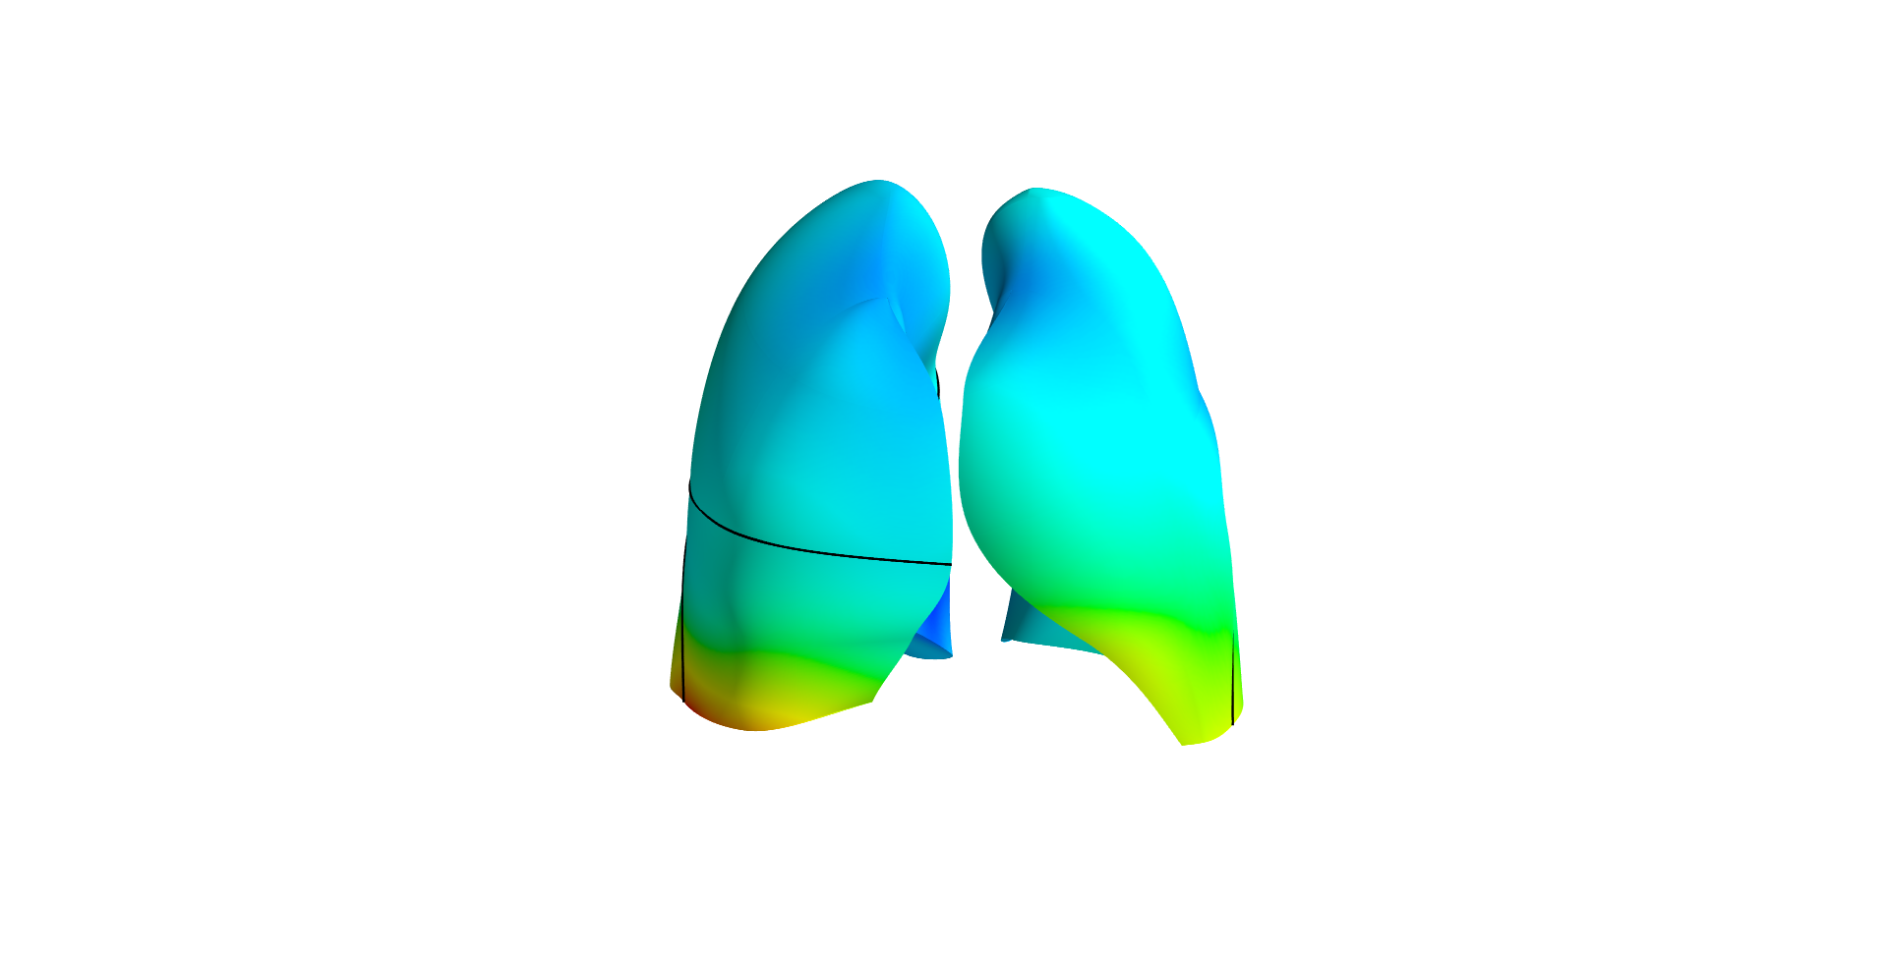
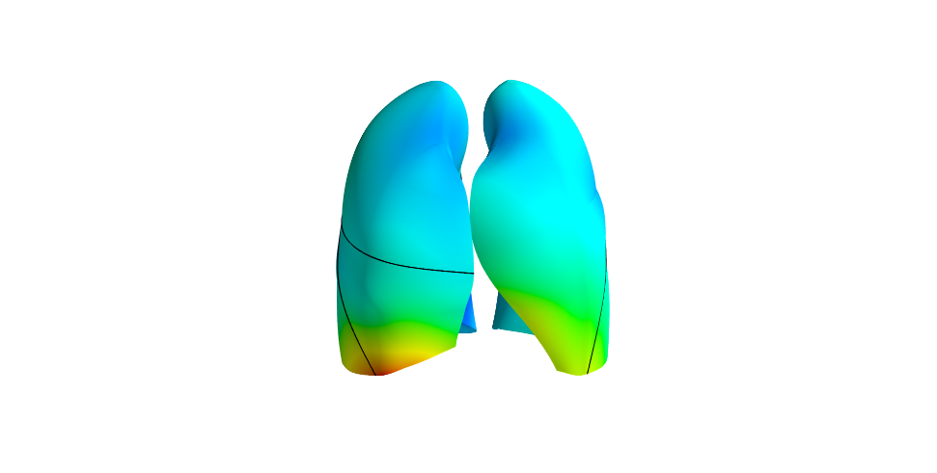
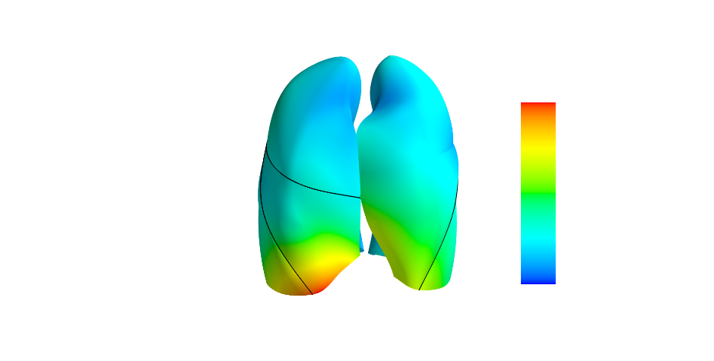
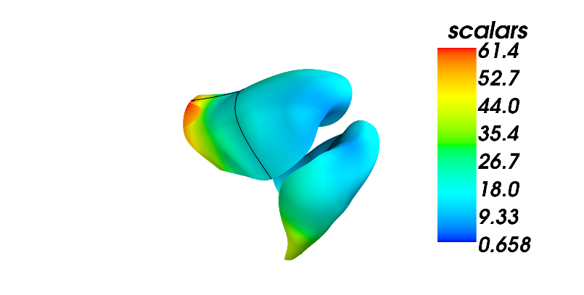
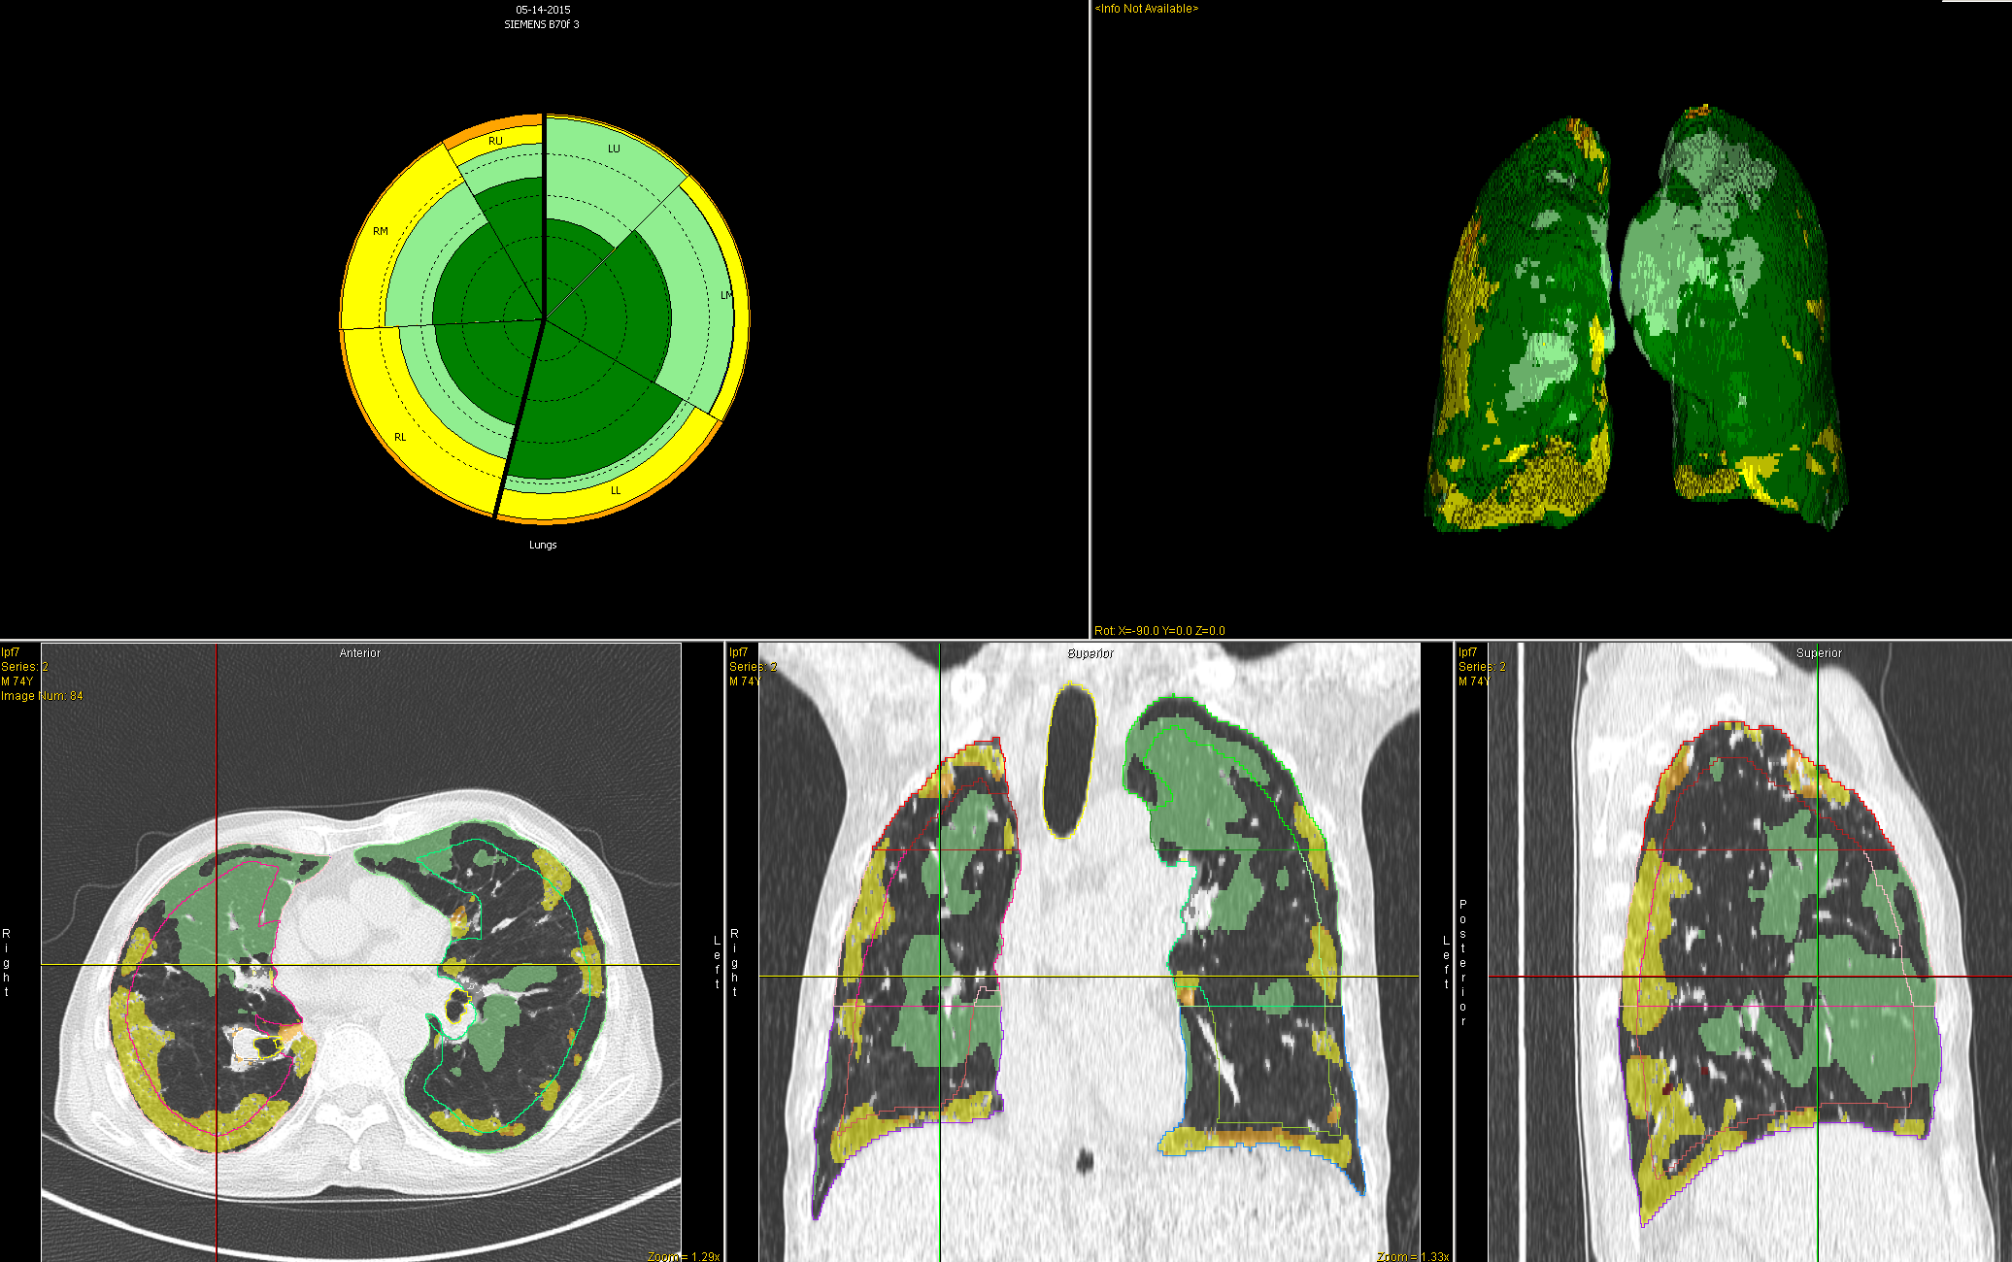
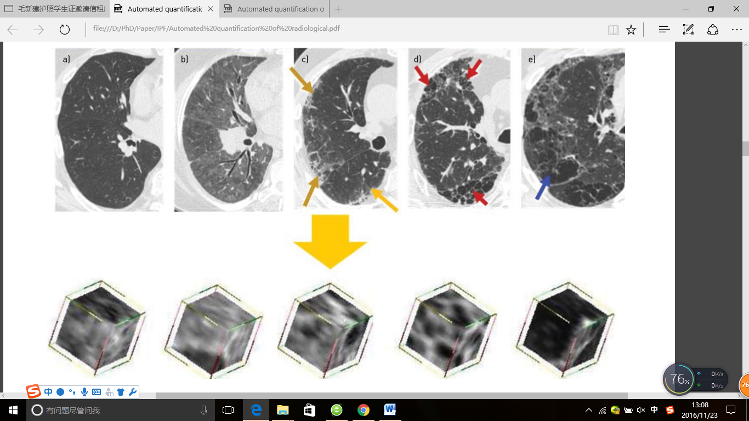
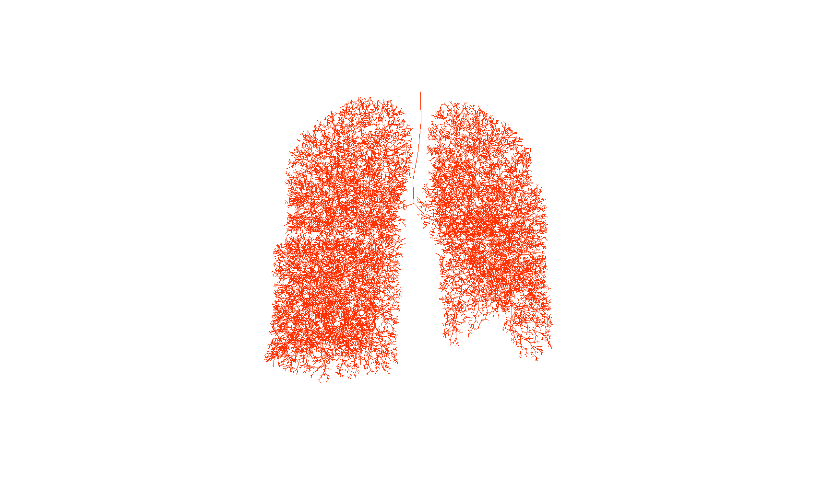
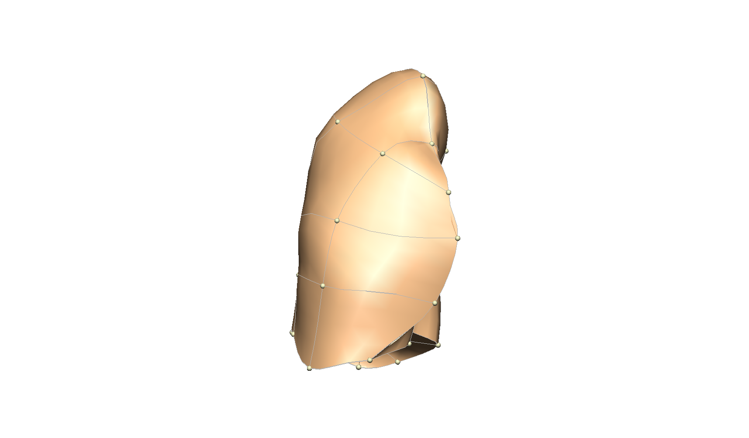
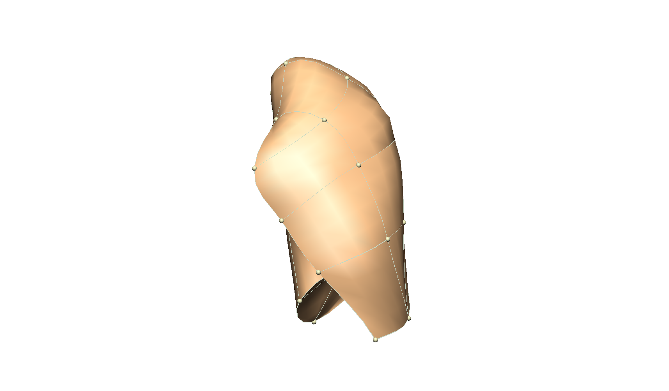
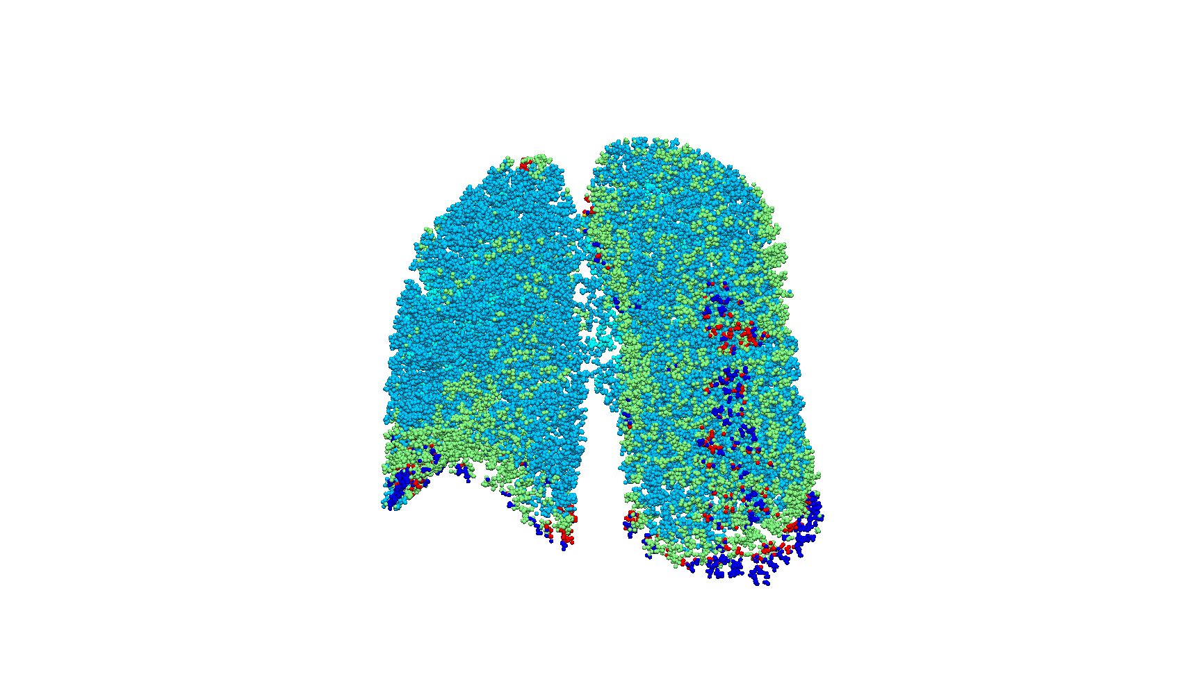
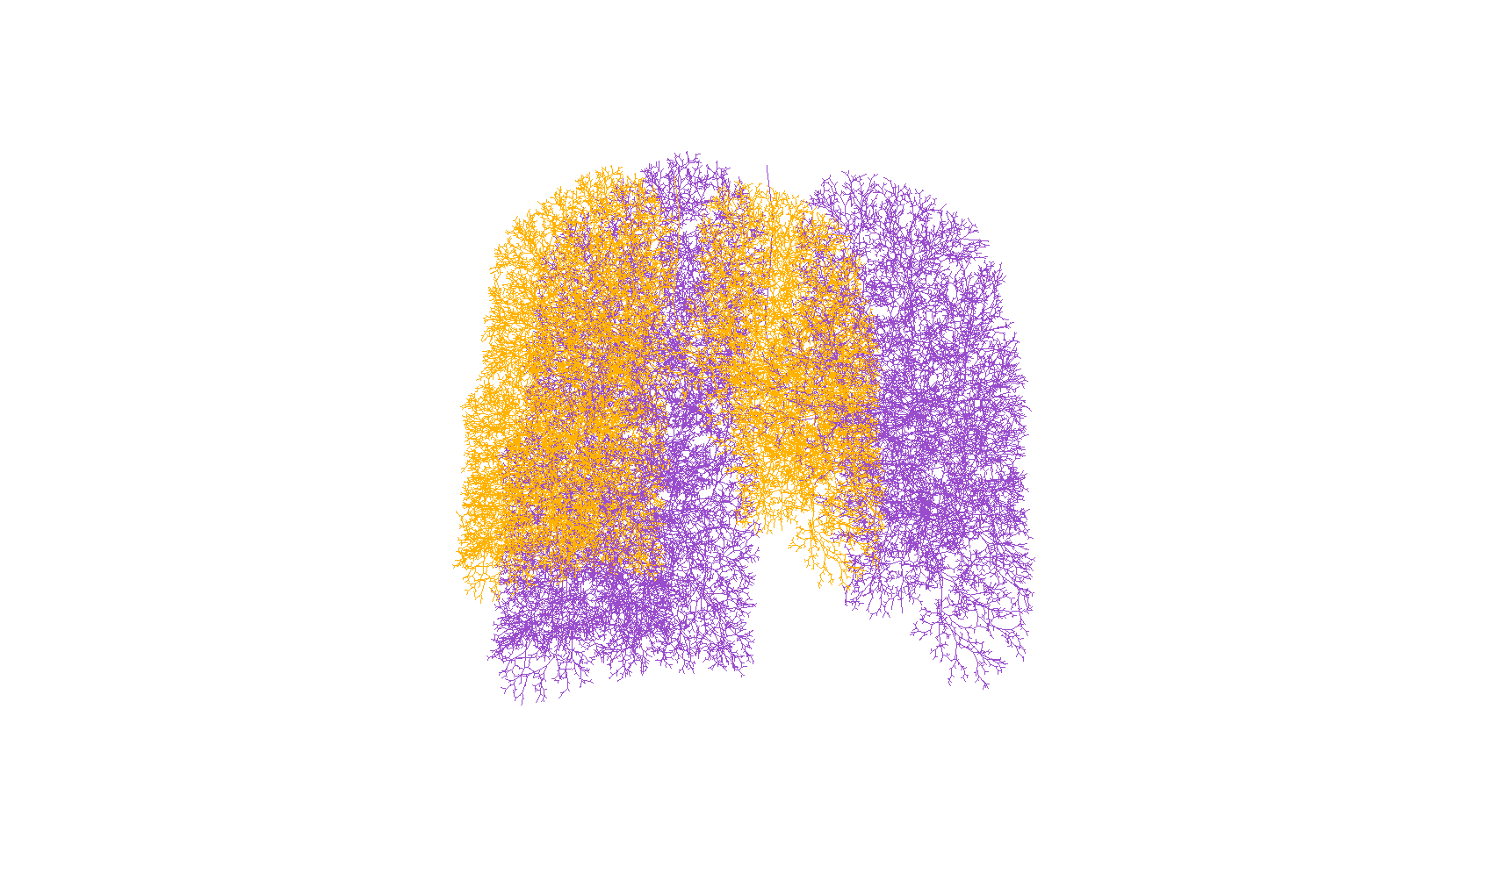
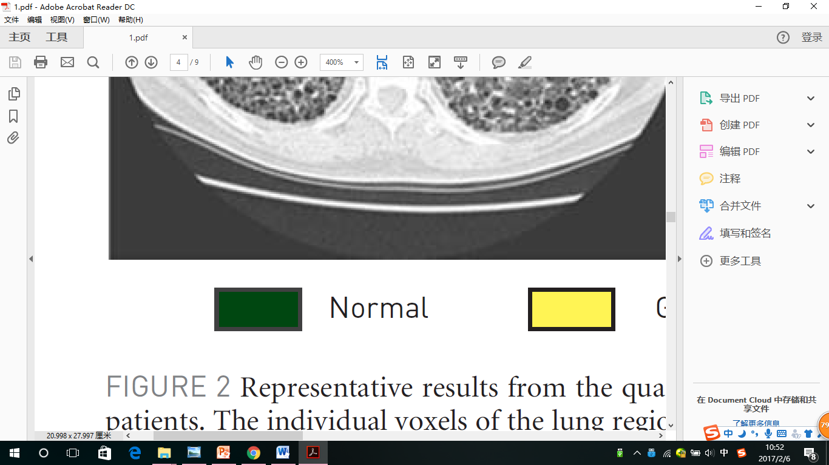
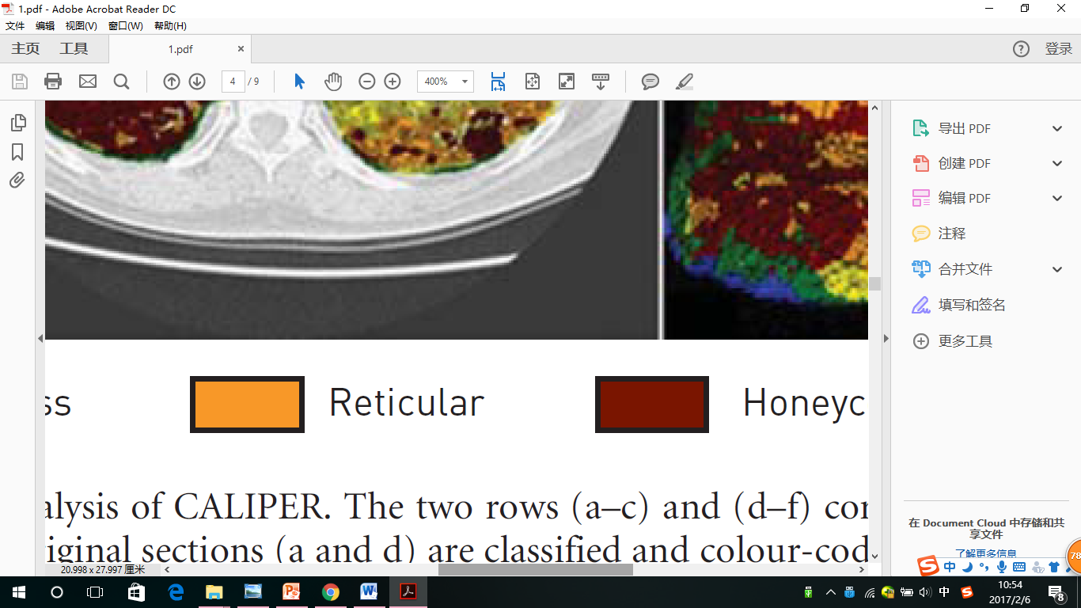
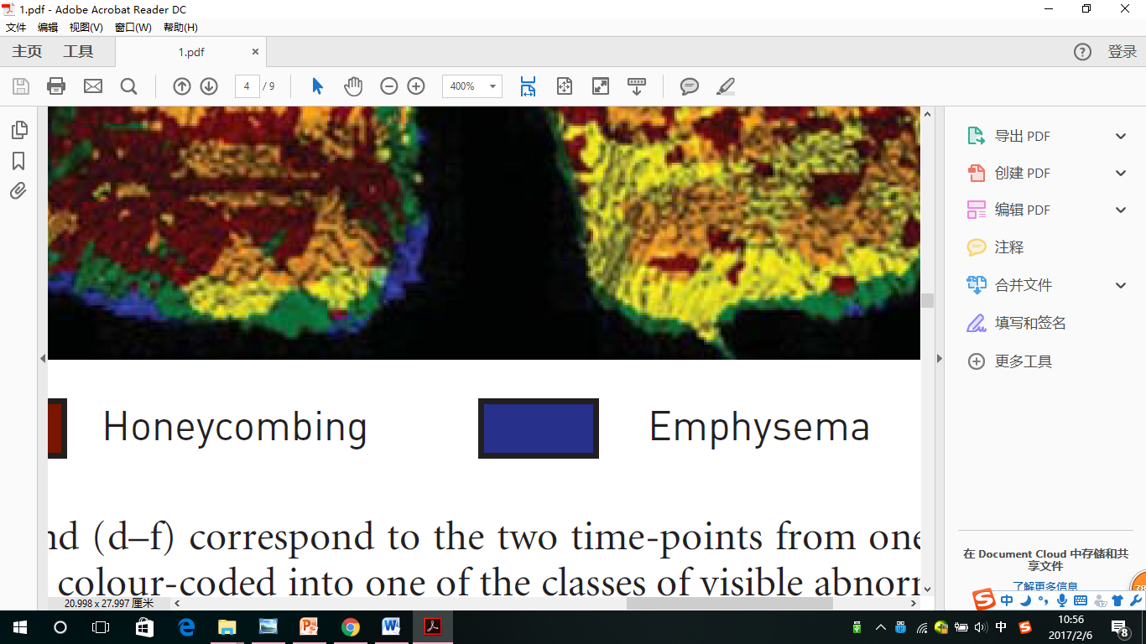
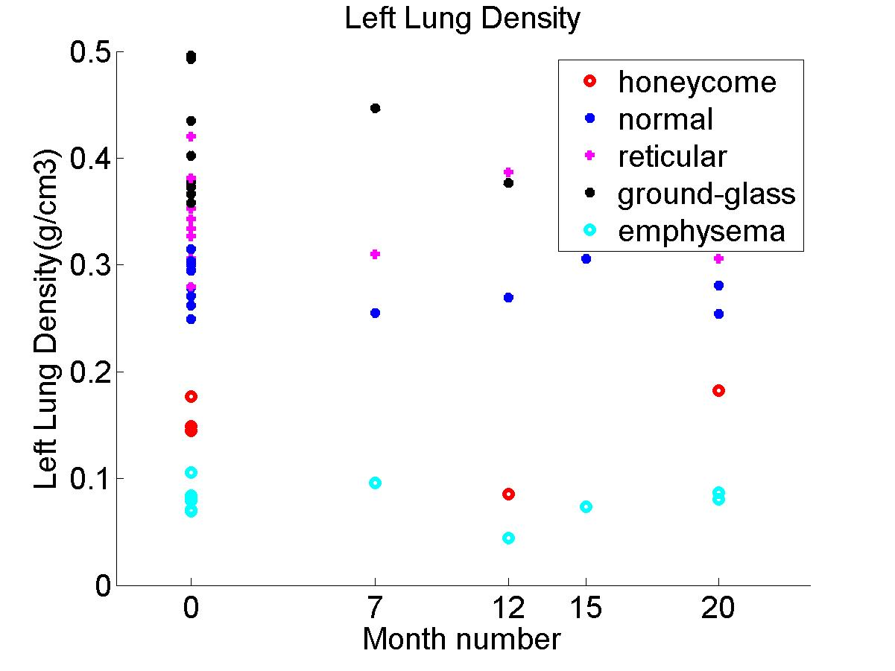
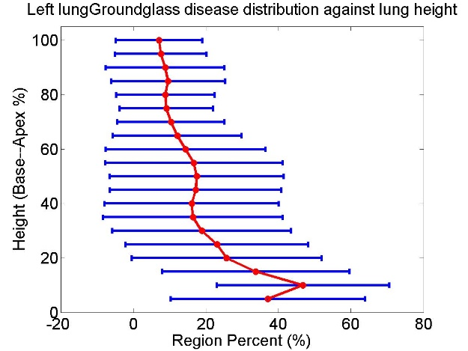
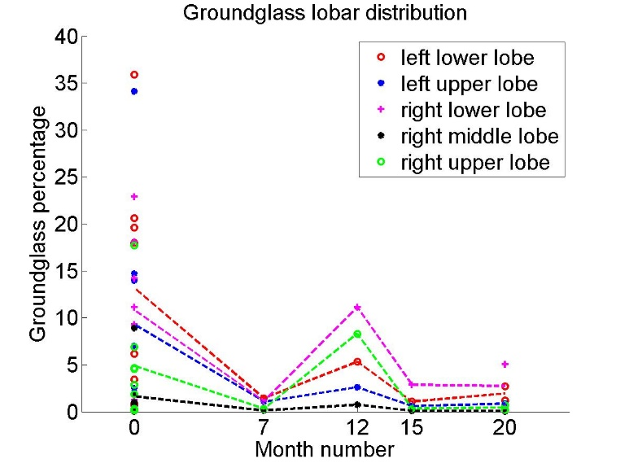
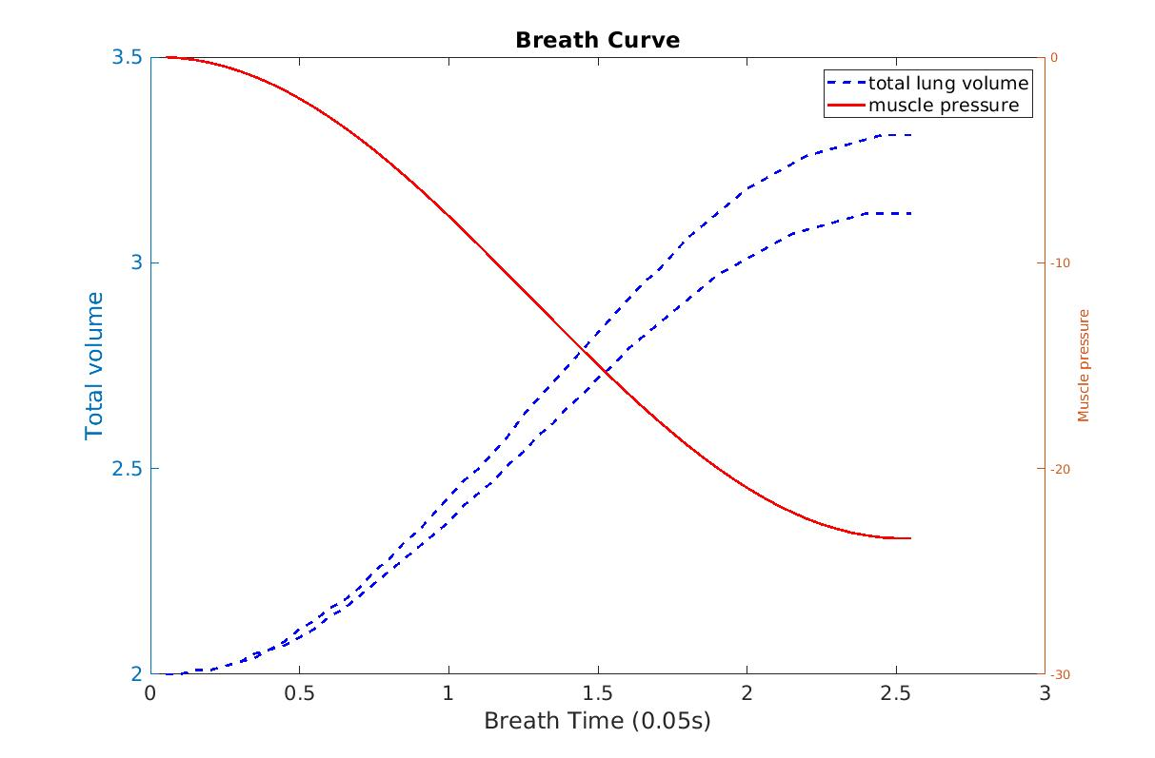
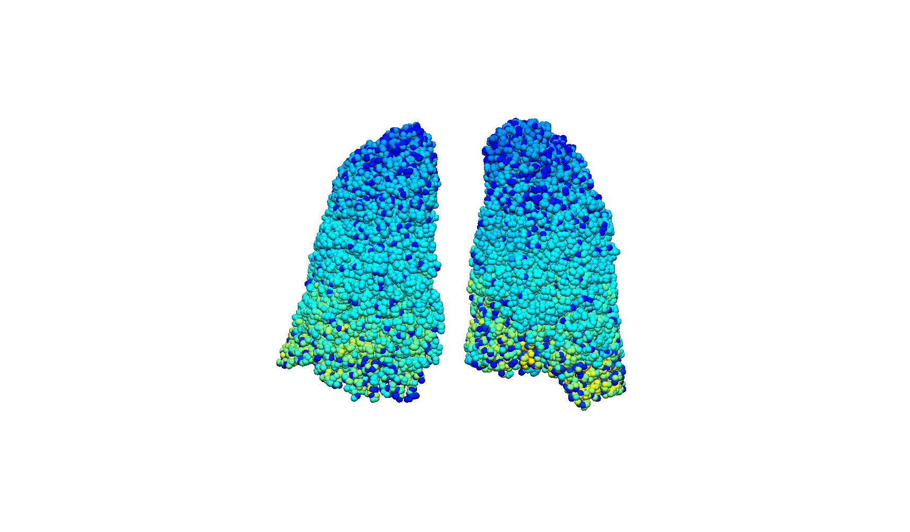
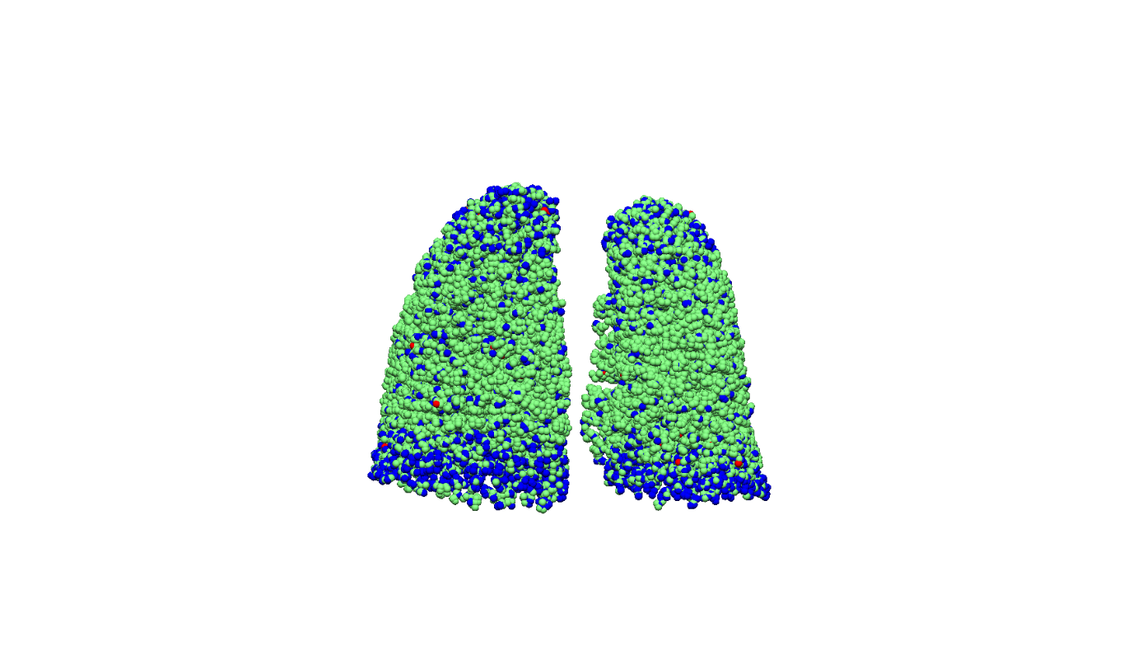
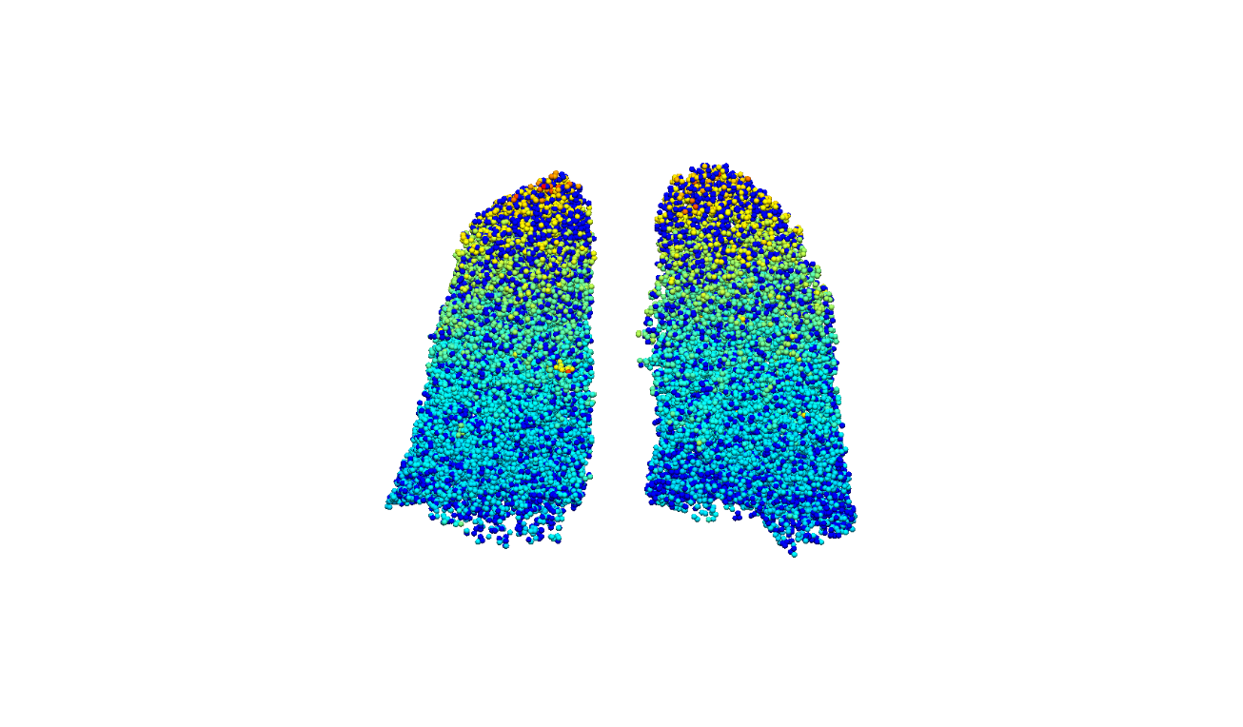
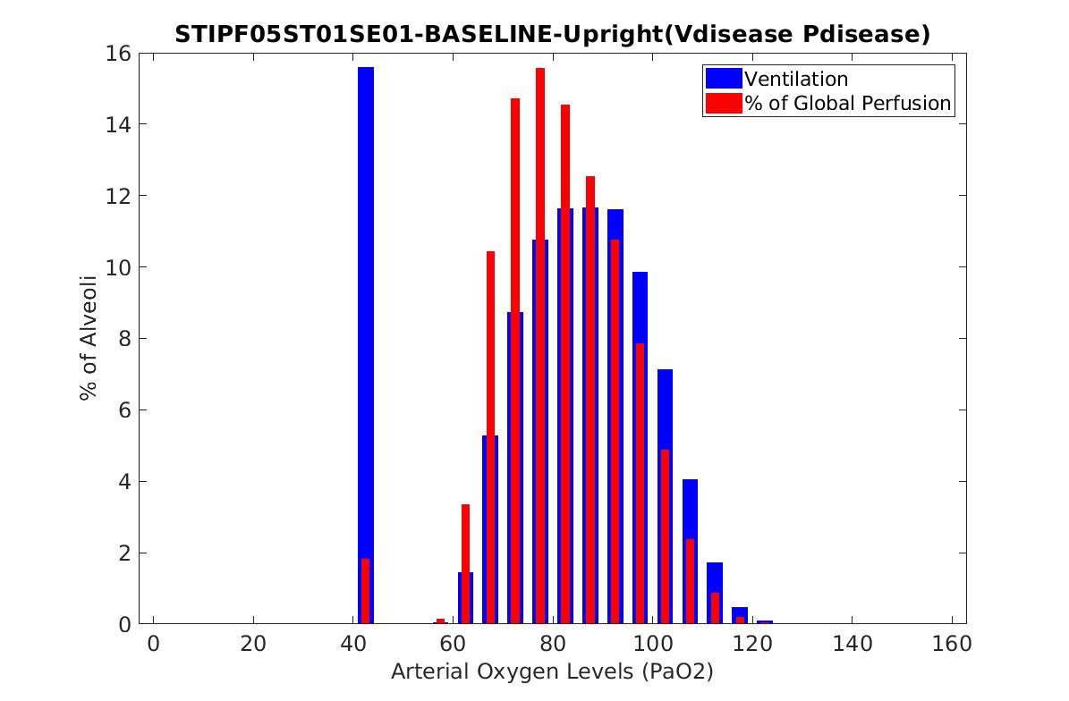
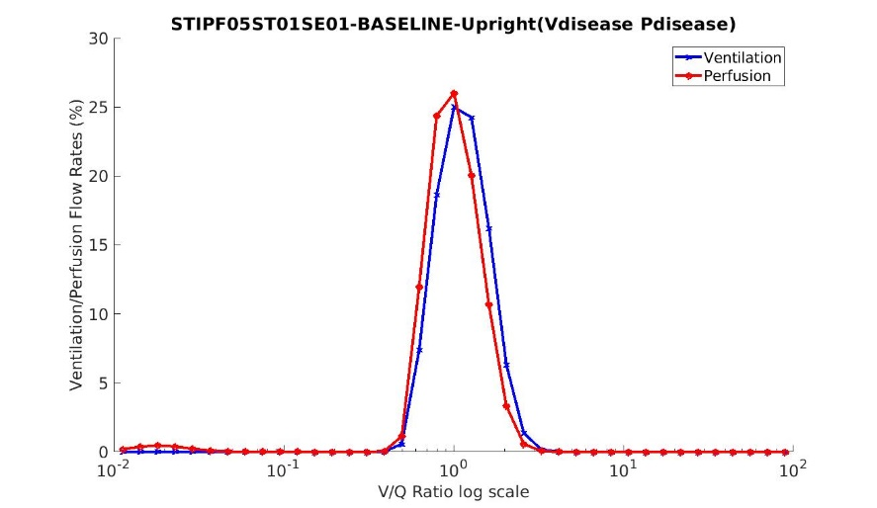
Idiopathic pulmonary fibrosis: a study using volumetric imaging and functional data in a computational lung model
Yuwen Zhang, Alys Clark, Haribalan Kumar , Merryn Tawhai, Auckland Bioengineering Institute, The University of Auckland, New Zealand
David Milne, Margaret Wilsher, Auckland City Hospital, Auckland, New Zealand
Brian Bartholmai, Department of Radiology, Mayo Clinic, Minnesota, US
Introduction
Analysis 2 Statistical shape model based shape analysis
Idiopathic pulmonary fibrosis (IPF) is an aggressive idiopathic interstitial pneumonia, and often occurs in elderly adults. In IPF, fibrosis typically develops preferentially in posterior-basal lung regions, and often co-exists with emphysema. Currently it is not clear how - or whether - the spatial distribution of tissue abnormalities in IPF (including classifications of tissue type) correlate with pulmonary function tests (PFTs) and their change over time. This work aims to develop a new quantitative tool that integrates data from volumetric imaging, PFTs, and computational models for lung function, to understand differences between IPF and normal older lungs.
Training data collection
Principle component shape feature analysis
Statistical shape model construction
Specific subject projection
The first principal SSM mode relates to the anteroposterior diameter of the lung, and the ratio of apical and basal diameters
The first principal SSM mode (>20% of the shape variation in normal lungs) is significantly different between IPF and normal .
For IPF subjects, the first mode has a strong relationship with fibrosis percent..
There is a significant difference of right lower lobe and right middle lobe between normal old and IPF lungs.
Tissue classfication
Data- Clinical IPF CT data from Auckland City Hospital 8 patie nts, 4 of them contain more than one time point scan for each
Mode1 -3 SD
Mode1 -2 SD
Mode1 0 SD
Mode1 1 SD
Mode1 3 SD
Pulmonary parenchyma classification - CALIPER (Computer-Aided Lung Information for Pathology Evaluation and Ratings) classification of abnormalities based on signature mapping techniques
Analysis 3 Patient-specific computational modelling of lung function
PFT result: FRC, TLC, DLCO, FEV1, FVC ……
Step1: Airway and vessel tree generation with disease labeling
Normal Ground-glass Reticular Honeycomb Emphysema
Analysis Qantitative analysis of disease from classified data
Paramiterize
modeling
Tree generation
Tree mapping
Tree disease labelling
Tree scaling
Step 2: Ventialtion and perfusion simulation
Paramiterize
modeling
Physiological knowledge of IPF patients: increased airway volume and vessel volume, decreased dead space, lung compliance and diffusion capacity
Abnormalities on CT scan derived curve
Real inspiration curve
Simulated firbrosis distribution
Inhale volume and pressure curve
Disease perfusion distribution
Summary
Fibrosis usually has a consistently higher TD (0.34/0.41 for reticular/ground-glass) compared to normal tissue (0.28) over time. In contrast, emphysema has lower density (0.08)
. The percentage of ground-glass decreases gradually with the increasing of the lung height. In contrast, the percentage of emphysema roughly keeps a rising trend.
Fibrosis presents predominantly in lower lobes (72%, 58%, 65% for honeycomb, reticular, ground-glass). But emphysema appears predominantly in upper lobes (73%).
We classified the pulmonary parenchyma representing IPF features， and performed quantitative analysis of IPF lungs.
The quantitative analysis combined with PFT result were used to drive a patient-specific computational modelling of lung function, and explore the relationship between V/Q mismatching and disease distribution
Step 3: V/Q distribution (gas transfer modeling)
Acknowledgements – Clinical data for this study was provided by Drs ML Wilsher and DG Milne, Auckland City Hospital; CALIPER analysis was conducted by Dr B Bartholmai, The Mayo Clinic.
V/Q distrubution
PaO₂ distribution
MIGET plot
3D grid density visualization

